Slide 1
Updating the Forget Gate of the LSTM to Improve Pattern Learning
By: Preston Robertson
Notes:
Introduce ourself, what we do and the department

Slide 2
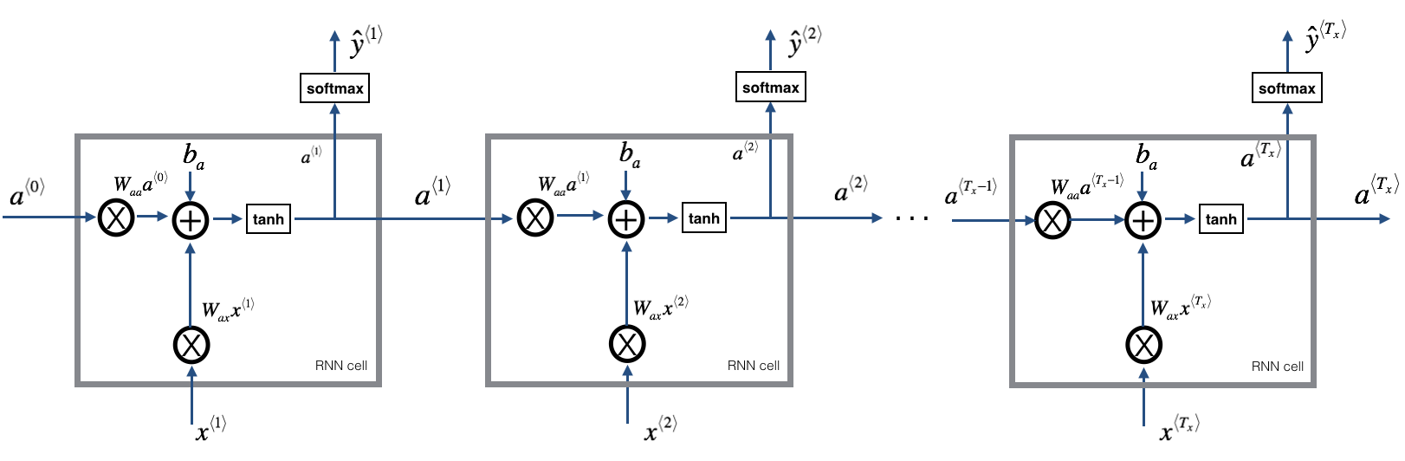
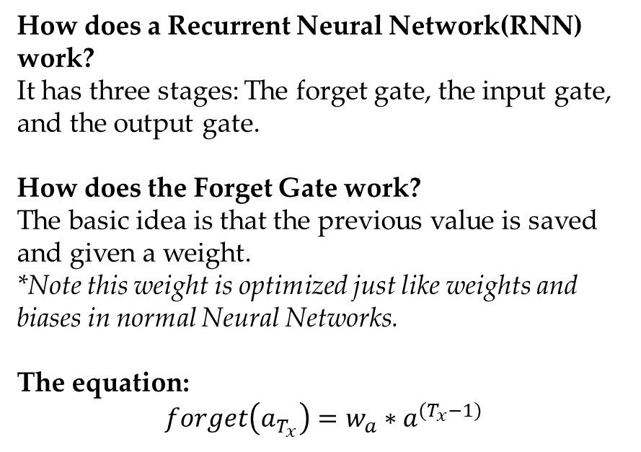
Basics/Background
2
How does a Recurrent Neural Network(RNN) work?
It has three stages: The forget gate, the input gate, and the output gate.
How does the Forget Gate work?
The basic idea is that the previous value is saved and given a weight.
*Note this weight is optimized just like weights and biases in normal Neural Networks.
The equation:
$$forget\left(a_{T_{x}}\right)=w_{a}∗a^{{(T}_{x}−1)}$$
Notes:
Ask them to tell us in their own words what AM
History

Slide 3
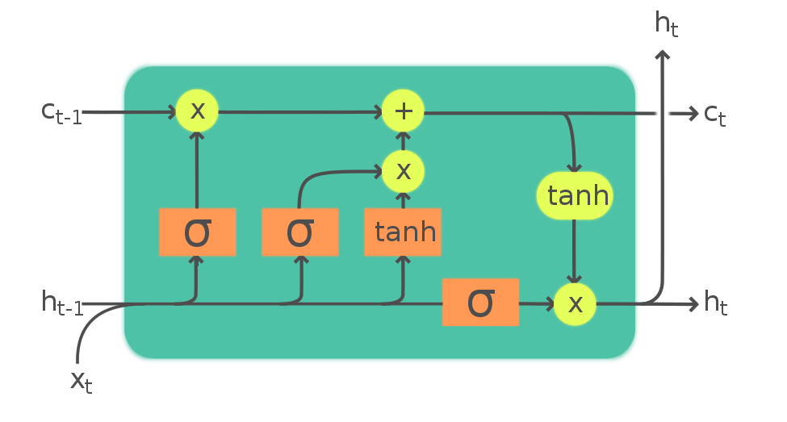
The Problem of RNN
3
The saturation of RNN models
Overtime the RNN model will have a saturation effect on the model.
*Meaning the impact Output 1 had on Output 2 is probably way greater than the impact of Output 44 has on Output 45
The solution to over-saturation in RNN Models
Researchers have determined by adding a “Long- and Short-term memory” to the RNN reduces the saturation.
It does this by having the previous output having its own interaction.
Notes:
Ask them to tell us in their own words what AM
History

Slide 4
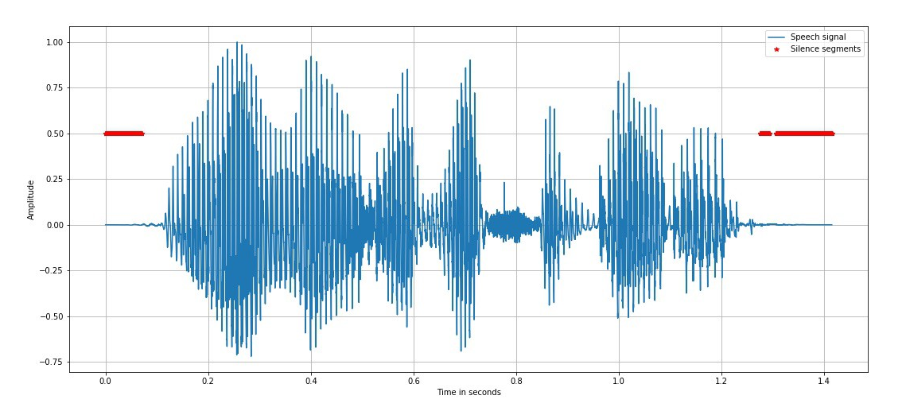
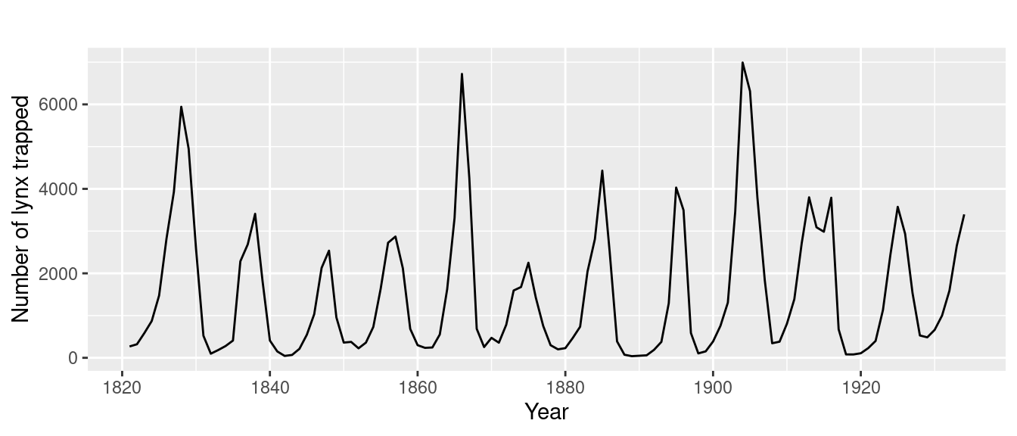
The Problem of LSTM
4
The saturation of LSTM models
Overtime the LSTM model will still have a saturation effect on the model. The LSTM fixes the most recent of data points being over-shadowed; however, all values are still being put into one term.
*Meaning that the impact Output 2 has on Output 4 is far greater than the impact Output 2 has on Output 6
The ability to lose all information
Since the forget-gate is a single term passed through-out the RNN, if the weight is ever set to 0, all previous information is lost.
*This can happen in a gradient as well, for example, if the weight drops to .1 or lower, all previous information is essentially not impactful.
Notes:
Ask them to tell us in their own words what AM
History

Slide 5
Proposed Solutions
5
Solution 1:
Implementing a multi-track system where inputs are taken at specific intervals (on top of the LSTM model)
This would theoretically allow for more/better pattern learning.
This would need to be another variable that is either tuned before the experiment or during.
Solution 2:
Storing all cell states and calling back cell states with similar values. More specifically the ones after.
Find where ht = mt (mt is where the cell states are stored). Then extract the m(t+k) cell states, where k is a tunable parameter.
Notes:
Ask them to tell us in their own words what AM
History

Slide 6

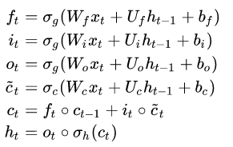
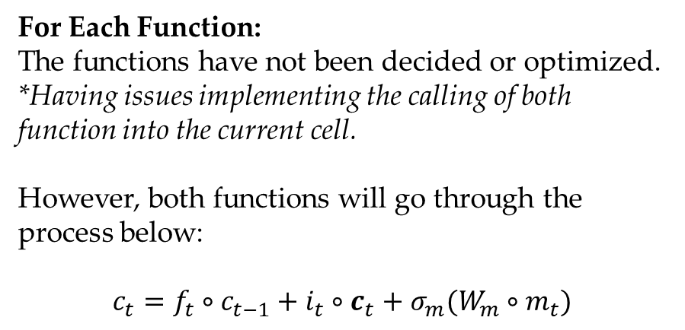
Proposed Mathematical Model
6
For Each Function:
The functions have not been decided or optimized. *Having issues implementing the calling of both function into the current cell.
However, both functions will go through the process below:
$$c_{t}=f_{t}∘c_{t−1}+i_{t}∘c_{t}+{σ_{m}(W}_{m}∘m_{t})$$
Notes:
Ask them to tell us in their own words what AM
History

Slide 7
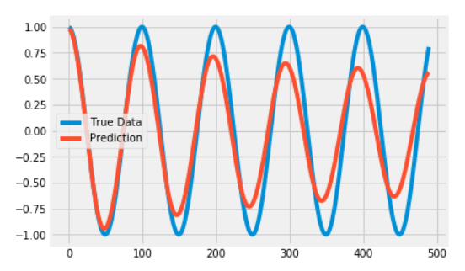
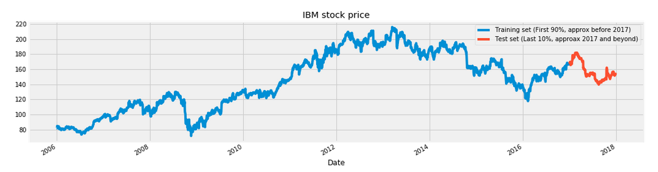
Method
7
Objective:
To accurately determine if these new solutions will be better for the accuracy of these models.
How?
Using pre-established LSTM, GRU, and RNN models on 5 datasets without the changes. Then on the same LSTM model and 5 datasets, run my changes to the forget gate and compare accuracy.
The Datasets
The datasets have not yet been decided; however, there will be 2 2D datasets (one being a basic function and the other a stock of a company), 2 image based datasets, and 1 speech-based dataset.
Notes:
Ask them to tell us in their own words what AM
History

Slide 8
What’s Next
8
Deciding the mathematical models for the proposed solution.
Deciding the datasets.
Implementing mathematical model into the LSTM code.
Running all 5 models on 5 datasets.
The sooner the start, the better since this will be computationally expensive.
Report findings in the final paper.
Notes:
Ask them to tell us in their own words what AM
History

Slide 9
Possible Future Work
9
Solution 1:
Taking the derivative at each point in the k iteration, instead of taking the values.
*The derivative/gradient will give more useful information but will be much harder to implement. (starting small)
Solution 2:
Implementing a small neural network to detect trends/support vectors to find mt and relay that information to the current cell.
*This would be theoretically more beneficial then averaging the next “k” cell states after mt.
…
Notes:
Ask them to tell us in their own words what AM
History

Slide 10
Questions?
Notes:
Ask them to tell us in their own words what AM
History

Slide 11
References
Objective:
…
Method:
…
Set-up:
…
Conclusion:
…
Discussion:
…
Notes:
Ask them to tell us in their own words what AM
History

